Slide 1
Comparing Respiration

Slide 2
By the end of this Smart Lesson you should be able to:
1. | Describe the respiratory system of both fish and insects.
2. | Compare the respiratory system of fish and insects.

Slide 3
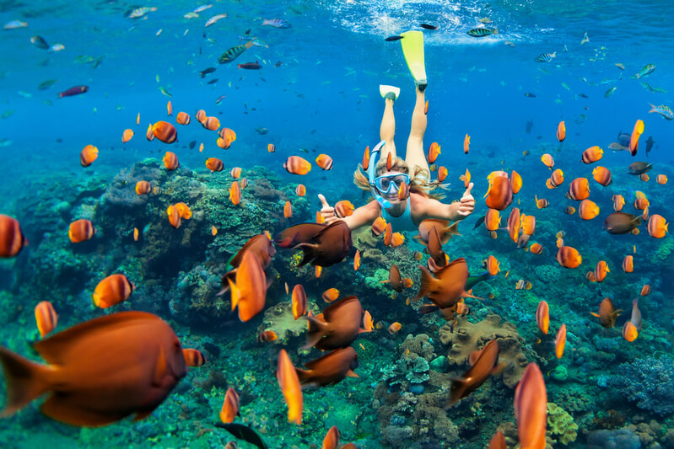
One obvious difference between humans and fish is their environment in which they live.
Humans are adapted to live on land whereas fish are adapted to live in the water. Because of this, fish have specialised structures in their bodies to help them extract oxygen from the water.

Slide 4
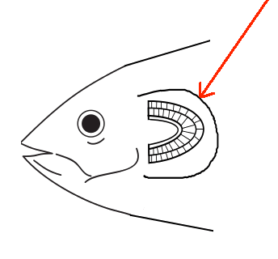
Respiration in Fish
Fish take water in through their mouth, which then flows over the surface of specialised structures, known as the gills.
Gills are the respiratory organ of aquatic animals.

Slide 5
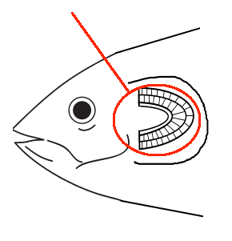
Respiration in fish occurs at the gills
Along the surface of the gills respiration occurs. Oxygen diffuses into capillaries while carbon dioxide diffuses out into the water.
Humans exhale air out of the lungs, whereas in fish, the water flows out of the gills through structures called the gill slits.

Slide 6
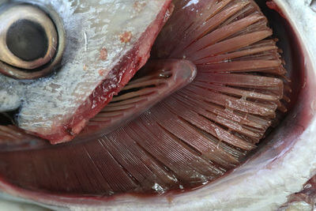
In fish, gas exchange occurs between the water they live in and their circulatory system.
Water contains less oxygen than air, so the fish's respiratory system is different to our own.
In fish, gas exchange occurs through gills.

Slide 7
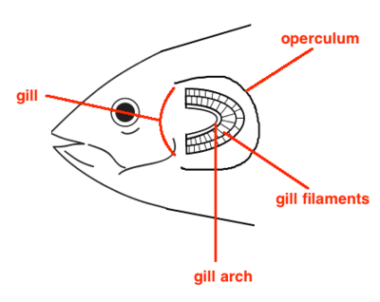
Gills are highly folded fleshy organs located behind the fish's head.
They provide a large surface area for gas exchange and are well supplied by capillaries.

Slide 8
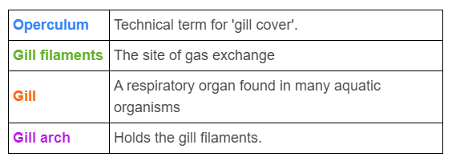

Slide 9
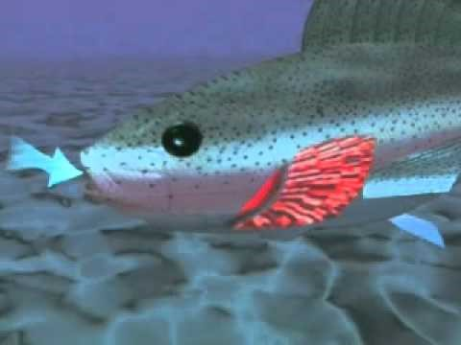

Slide 10
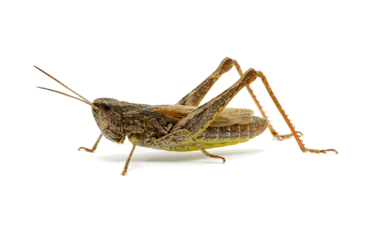
Insects, unlike humans and fish, do not rely on a circulatory system to transport oxygen around the body.
In insects, air is transported through the body directly, without using a circulatory system to distribute oxygen.

Slide 11
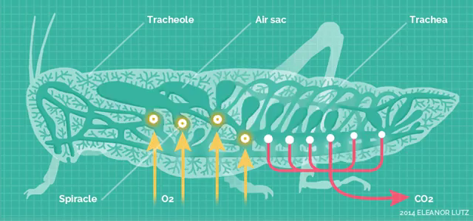
Small, specialised structures called trachea carry air around the body to moist air sacs.
In this way, they are able to directly supply every cell in the body with oxygen using only the respiratory system.

Slide 12
Spiracles on the outside of the body close during inactivity to prevent water loss and to keep the air sacs moist.

Slide 13
